Slide 1



Rover Tic-Tac-Toe
Alex Nolan, Sajan Ronvelwala, Sasha Morgan, Thomas Bellerose
Fall, 2018

Slide 2

Overview
A brief description of the section can be placed here. It does not need to be very long.

Slide 3

Constraints

Slide 4
Project Constraints
Economic: $400 budget
Available Hardware: Couldn’t use line follower

Slide 5
Robot Arm

Slide 6
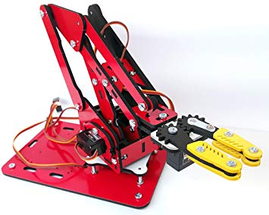

Choice of Robot Arm
Decided on a 4-Servo ArmUno 2.0 - 3 axis motion + claw for the servo
Within the price constraints of the project,
and large enough to manipulate a dry erase
marker as needed

Slide 7
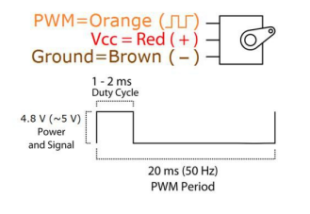
Robot Arm Control
Each of the arm servos is controlled by a pulse width modulated signal with a 20ms period.
An arm control library provides an API tell the arm to perform complex and simple motions.
Simple motions are things like setting a servo angle. Complex motions are time dependant motion paths, defined as a series of arm positions and the speed to move between them.

Slide 8
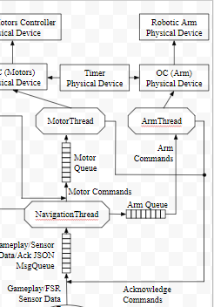
Integration
To meet the project requirements, complex motions to draw “X” and “O” were created
The arm thread performs actions depending on a sent of enumerated command messages sent to it
After finishing each action, the arm thread sends and acknowledge message back to the navigation thread to indicate it is done.

Slide 9
Motors

Slide 10
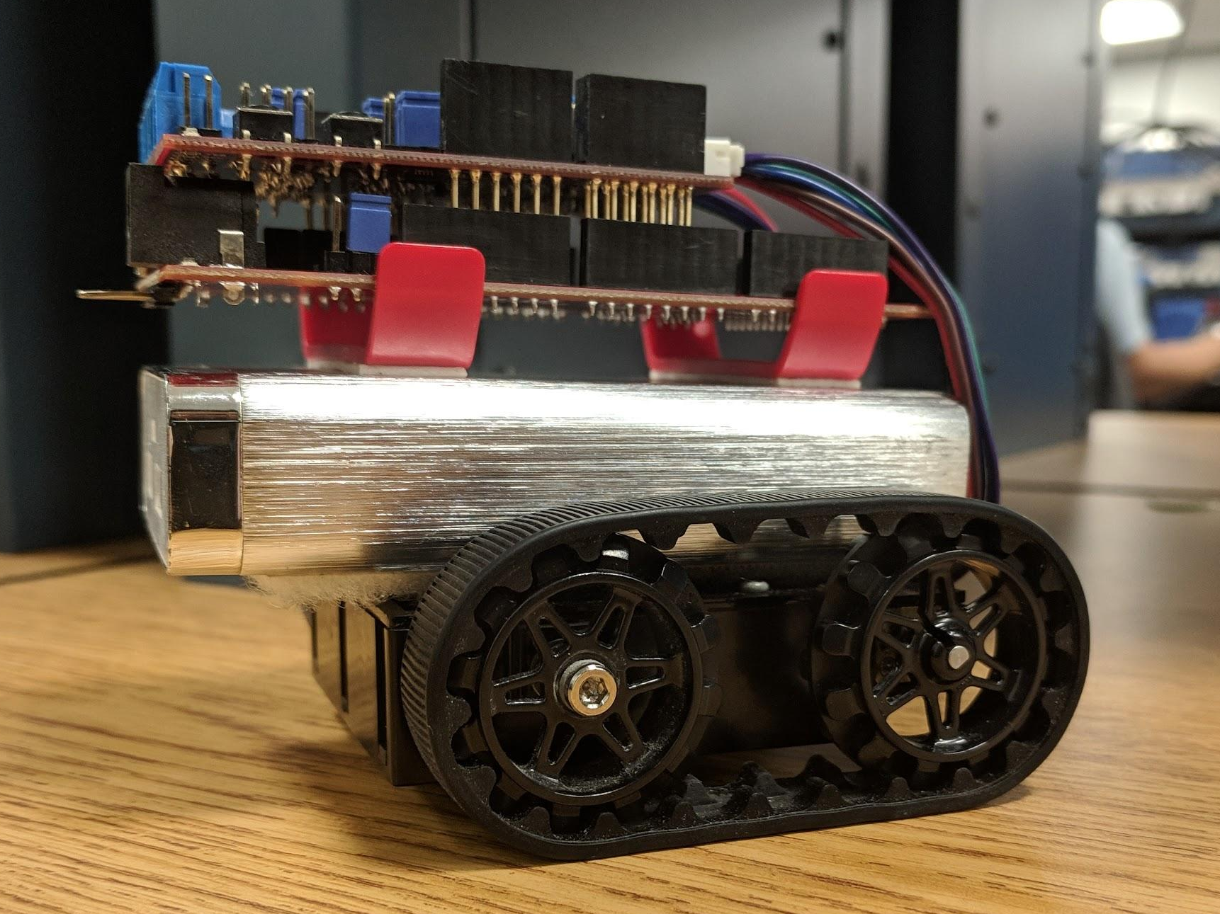
Motor Control
Designed an API to:
Move rover forwards/backwards a given distance using encoders
Turn rover left/right a given angle using encoders
Asynchronously stop the motors
Incorporate a PID feedback control loop

Slide 11
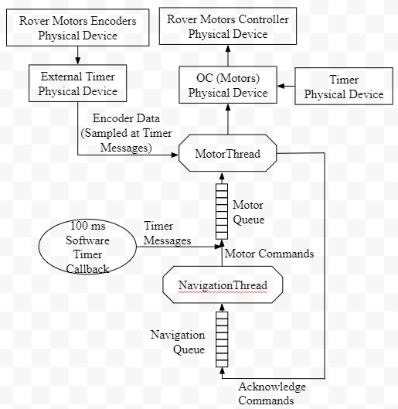
Implementation
Motor Thread:
Receives movement commands from navigation thread in it’s queue and controls the motors accordingly
Reads encoder values when timer messages are received every 100 ms in it’s queue and adjusts the motor PWM signals accordingly
Acknowledges sent to navigation queue when movements are complete

Slide 12
Sensors

Slide 13
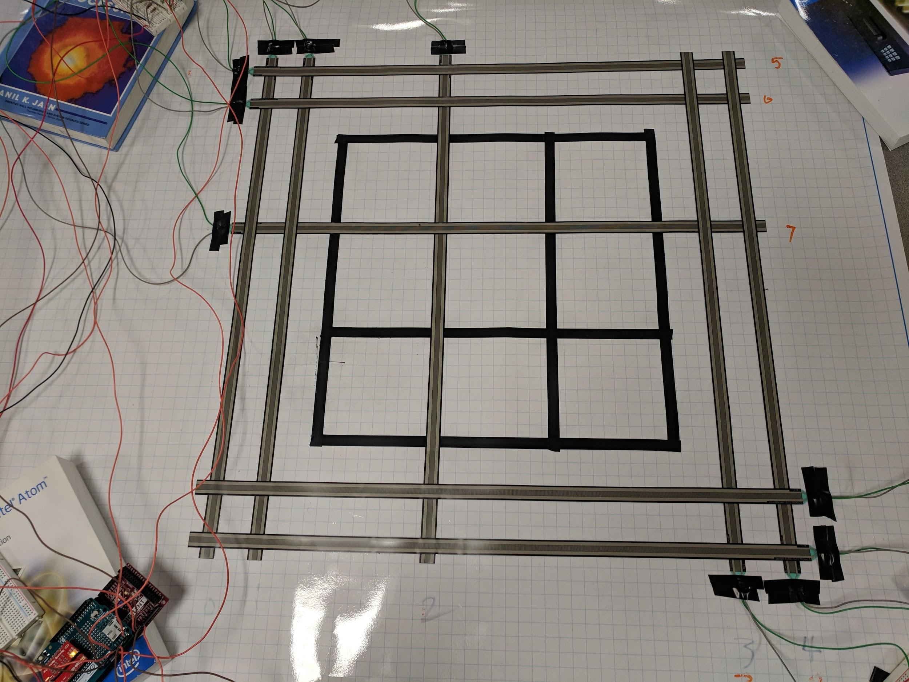
Force Sensitive Sensors
Sensors are used to determine the rover’s location.
Sensor Type: Extra Long Force Sensitive Resistors
Functionality:
Resistive value is based on the amount of pressure applied
Pressure decreases the resistance which in turn increases the Analog to Digital Converters readings

Slide 14
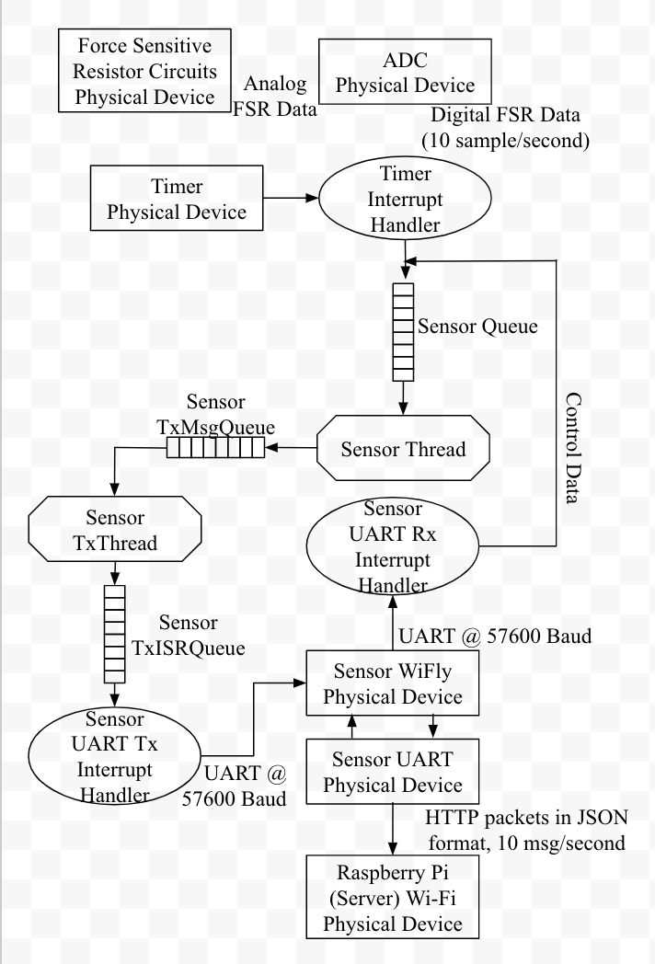
Implementation
Sensor Thread
Calibration routine is instantiated during start

Slide 15
Communications

Slide 16
Raspberry Pi HTTP Server
A brief description of the section can be placed here. It does not need to be very long.

Slide 17
Graphical User Interface

Slide 18
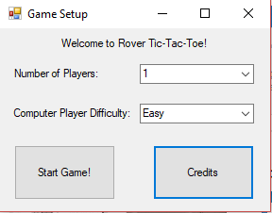
Settings GUI
A brief description of the section can be placed here. It does not need to be very long.

Slide 19
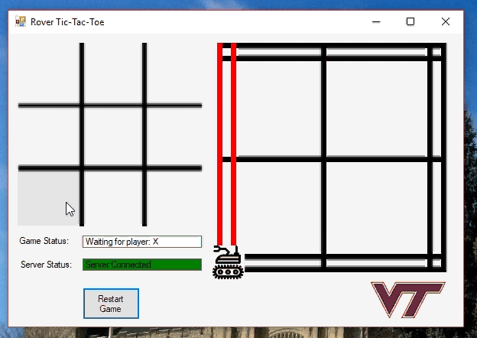
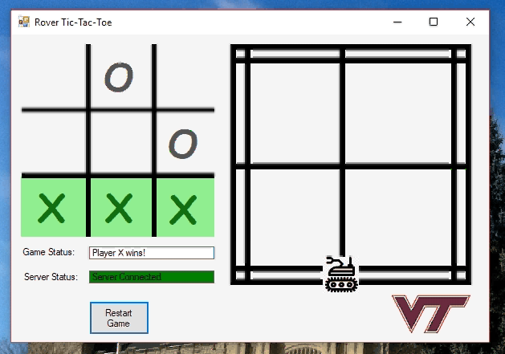
Gameplay GUI
A brief description of the section can be placed here. It does not need to be very long.

Slide 20
Navigation

Slide 21
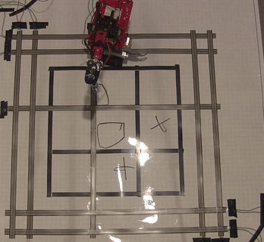
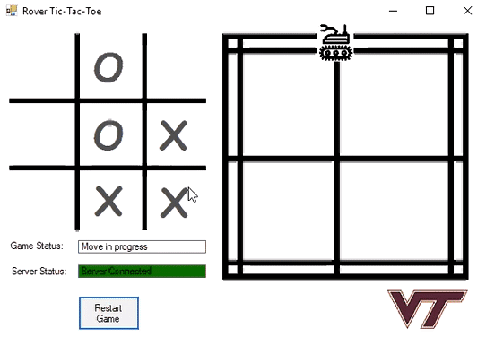
Direction and Mapping
The first zation is , determines the shortest direction of travel given a move.
Uses the current location as the state and changes states based on FSR input and Direction of travel.
Each state handles error, the number of corrections is limited during a set time period.

Slide 22
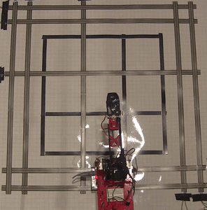
Command Function
Uses the direction, current position, FSR input, and the given move to send a series of commands to the motors and arm.

Slide 23
Reliability

Slide 24
Robot Arm Control
A brief description of the section can be placed here. It does not need to be very long.

Slide 25
Robustness

Slide 26
Robot Arm Control
A brief description of the section can be placed here. It does not need to be very long.

